Slide 1
Big Mountain Resort
Slide Deck
Jordan Maclin

Slide 2
Problem Identification
If Big Mountain Resort implements a dynamic, data-driven pricing strategy based on demand patterns, competitor pricing, and historical data, will it increase overall revenue by at least 15% without reducing customer demand by the end of December, 2025?
With the context that the Big Mountain Resort has recently added a new chair lift, increasing operational costs by $1,540,000 for the season.

Slide 3
Problem Identification
In this notebook, I cleaned and prepared the ski resort dataset for predictive modeling. The original file (ski_resort_data.csv) had 330 entries, each representing a ski resort in North America—including our resort of interest, Big Mountain Resort, which I confirmed is included.
After cleaning, the final dataset (ski_data_cleaned.csv) has 277 rows—a 16% reduction from the original. This version preserves the important information while being more suitable for building a predictive model.
With the data preparation complete, I was ready to move on to exploratory analysis and feature selection. The target variable for our model will be 'ticket_price', representing the daily cost of a lift ticket at each resort.

Slide 4
Recommendations and Findings
Big Mountain currently charges about $110 per day ticket. Modeling suggests a ticket price of $120-$130 is feasible due to new facilities, with a $3.00 increase in support for the ticket price from this scenario, potentially yielding $5,250,000 over the season.
For future improvements, prioritize snowmaking expansion (beyond minor additions) and optimizing the longest run.
After modeling I believe scenario 2 is the best bet, to increase the vertical drop by adding a run to a point 150 feet lower down, require additional chair.

Slide 5
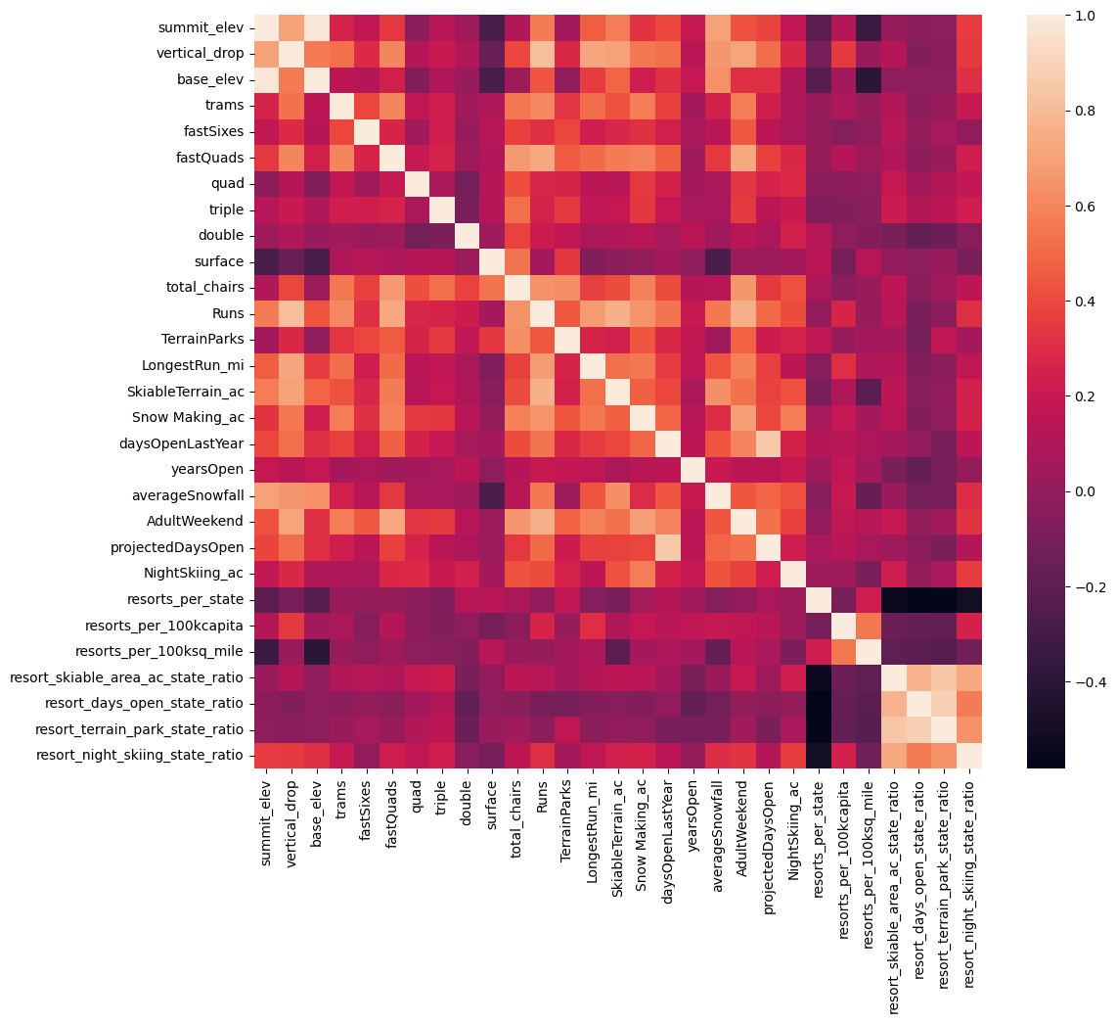
Modeling results and analysis
This heat map led to targeting the Adult weekend ticket price correlations for our model.
Shows high correlation with Run, total chairs, snowmaking AC, Vertical drop, and fast quads.

Slide 6
Modeling results and analysis
A linear regression model was then built with preprocessing steps like imputation, scaling, and feature selection. It showed moderate accuracy in cross-validation, and its test performance was consistent, identifying features like vertical drop and snowmaking as important predictors.
vertical_drop 10.767857
Snow Making_ac 6.290074
total_chairs 5.794156
fastQuads 5.745626
Runs 5.370555
LongestRun_mi 0.181814
trams -4.142024
SkiableTerrain_ac -5.249780
These results suggest that vertical drop is your biggest positive feature. This makes intuitive sense and is consistent with what you saw during the EDA work. Also, you see the area covered by snow making equipment is a strong positive as well. People like guaranteed skiing! The skiable terrain area is negatively associated with ticket price! This seems odd. People will pay less for larger resorts? There could be all manner of reasons for this. It could be an effect whereby larger resorts can host more visitors at any one time and so can charge less per ticket.

Slide 7
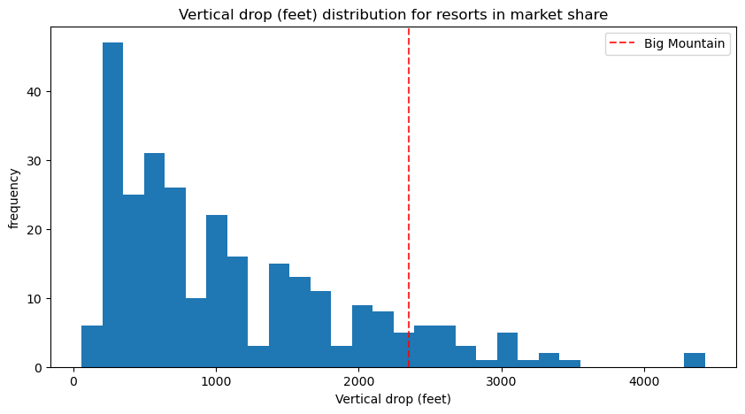
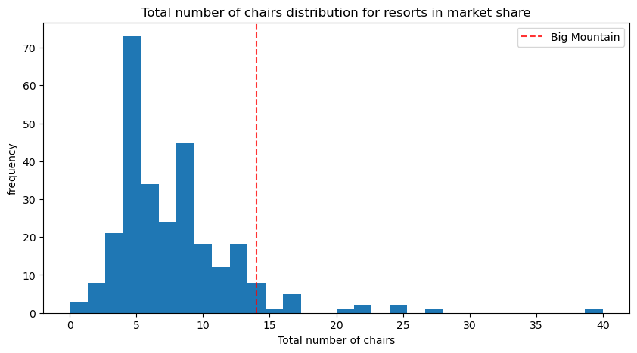
Modeling results and analysis
After training the model we compared the Data for Big mountain ski resort by plotting in histograms.
So comparing the feats that had a highest correlation with ticket price we see these are the most important areas we can improve on Vertical Drop and Total number of Chairs.

Slide 8
Summary and Conclusion
After modeling I believe scenario 2 is the best bet, to increase the vertical drop by adding a run to a point 150 feet lower down, require additional chair.
Modeling suggests a ticket price of $120-$130 is feasible due to new facilities, with a $3.00 increase in support for the ticket price from this scenario, potentially yielding $5,250,000 over the season.
Another note is Big Mountain's modeled price is significantly higher than its current price, a likely surprise to executives, indicating potential underpricing given its strong facilities.

